Slide 1
Aperture Science

Slide 2

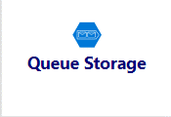

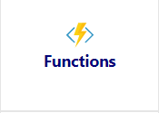
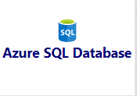

General Structure From A Thousand Miles Above
Request Queue
Request
Users
Trigger
Request Accepted
Request for result
Response Queue
Response
Response for result

Slide 3
API Sections
Activation Code
Enrollment
Accelerometer

Slide 4
Events
REQUEST
Activation Code
ActivationCodeRequestedEvent
ActivationCodeBatchRequestedEvent
Enrollment
EnrollmentRequestedEvent
CheckInRequestedEvent
Accelerometer
AccelerometerIngestRequestedEvent
AccelerometerIngestUserDataRequestedEvent
RESPONSE
Activation Code
ActivationCodeRespondedEvent
ActivationCodeBatchRespondedEvent
Enrollment
EnrollmentRespondedEvent
CheckInRespondedEvent
Accelerometer
AccelerometerIngestRespondedEvent
AccelerometerIngestUserDataRespondedEvent

Slide 5
Queues
REQUEST
Activation Code
Activation Code Request Queue
Activation Code Batch Request Queue
Enrollment
Enrollment Request Queue
CheckIn Request Queue
Accelerometer
Accelerometer Ingest Request Queue
Accelerometer Ingest User Data Request Queue
RESPONSE
Activation Code
Activation Code Respond Queue
Activation Code Batch Respond Queue
Enrollment
Enrollment Respond Queue
CheckIn Respond Queue
Accelerometer
Accelerometer Ingest Respond Queue
Accelerometer Ingest User Data Respond Queue

Slide 6
Functions
Activation Code
ActivationCodeGenerator
ActivationCodeBatchGenerator
Enrollment
Enrollment
CheckIn
Accelerometer
AccelerometerIngest
AccelerometerIngestUserData

Slide 7
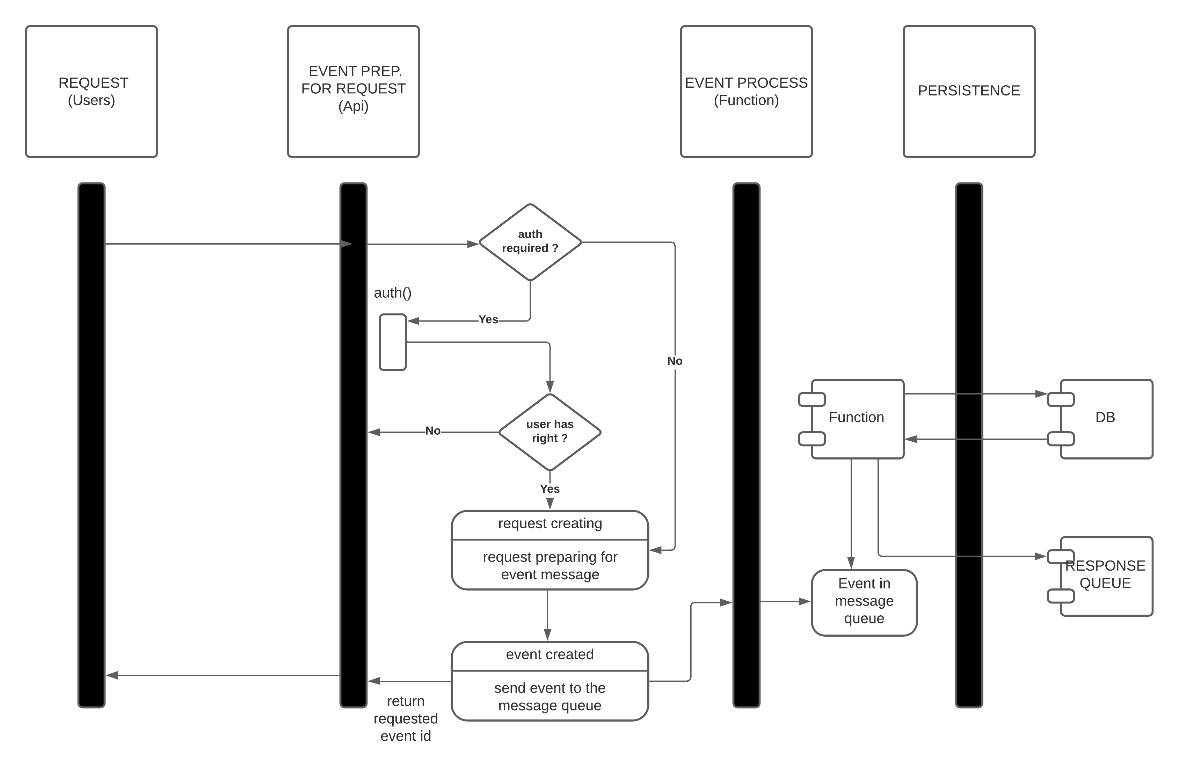
General Activity Diagram

Slide 8
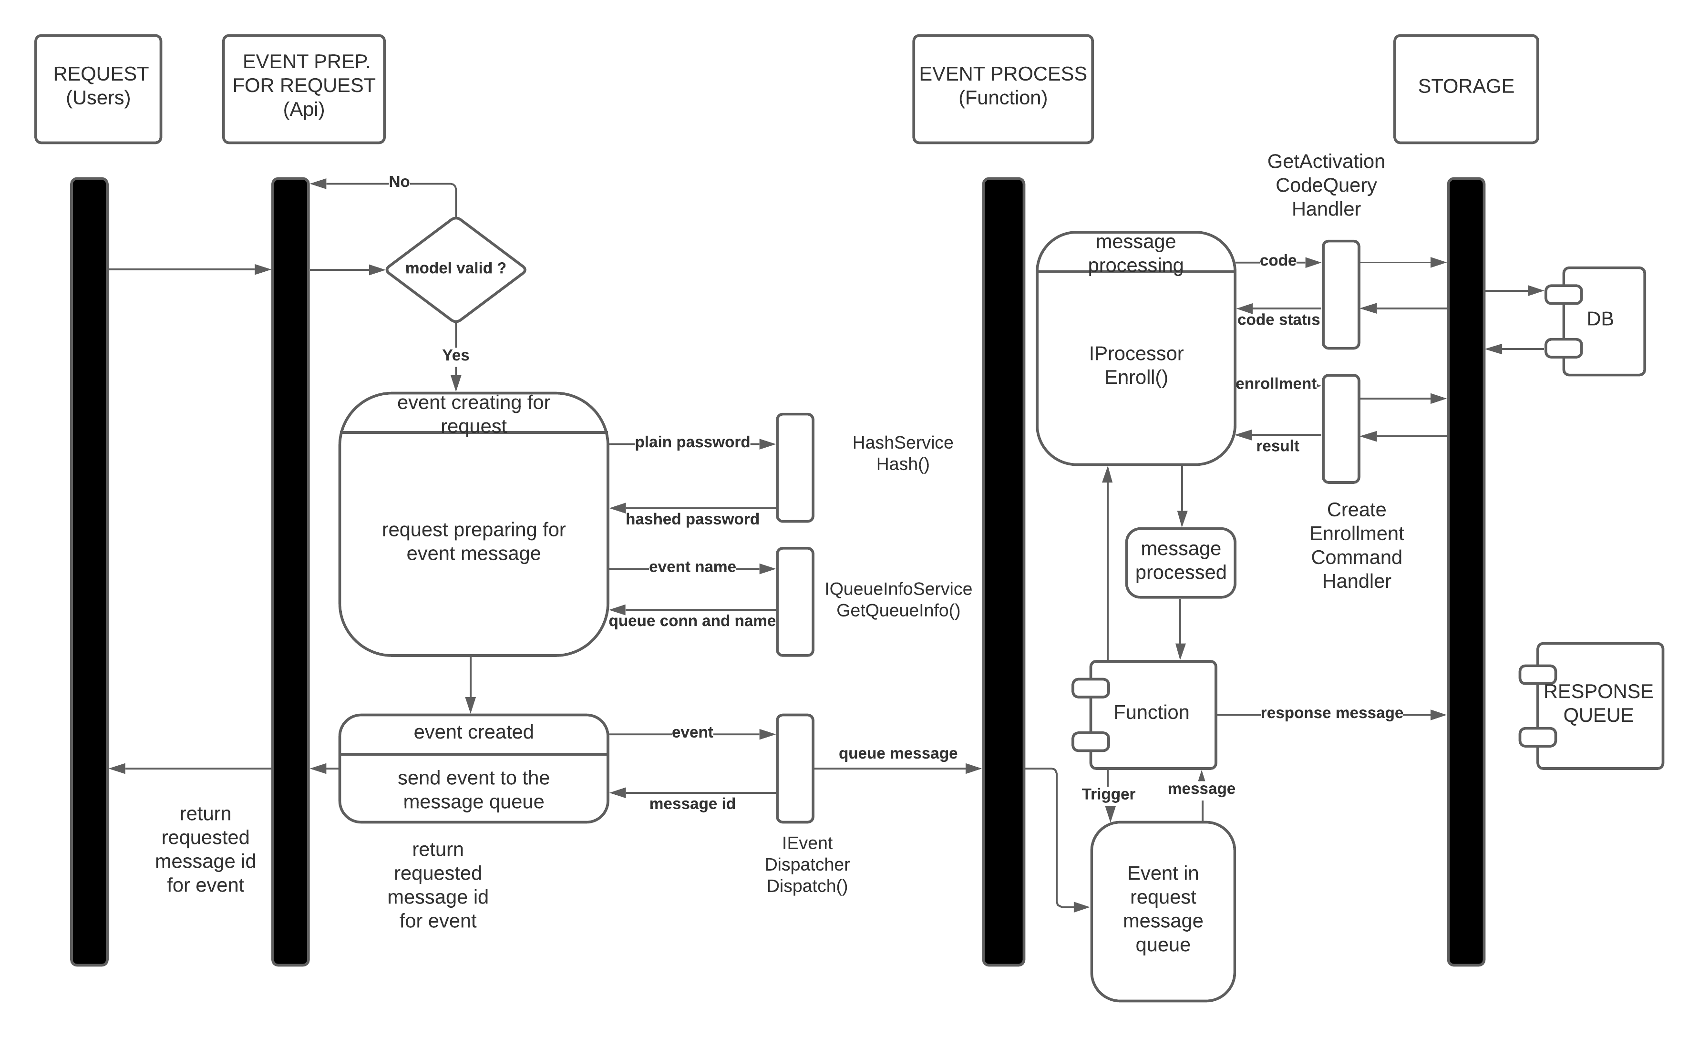
Create User Activity Diagram

Slide 9
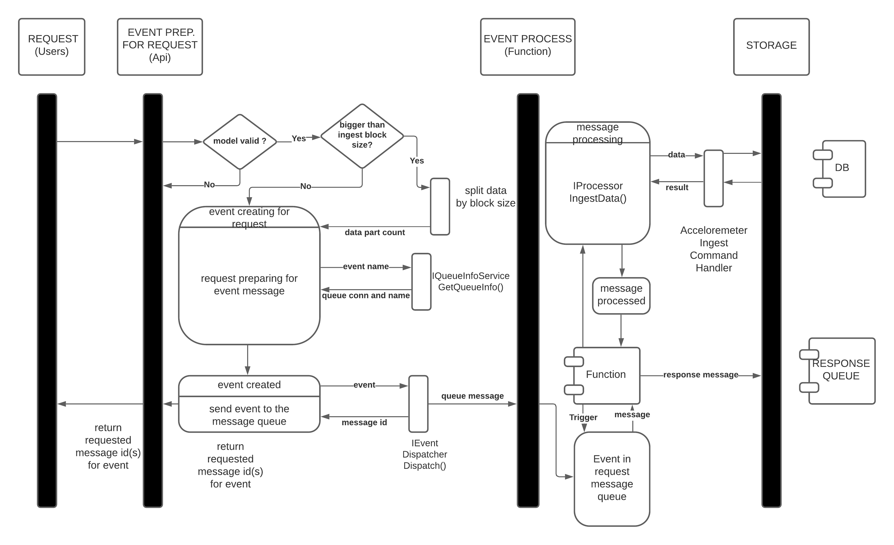
Ingestion of Acceleration Data Activity Diagram

Slide 10
TEST PLAN
SCOPES
API (end to end test with SpecFlow)
Domain (unit)
Data (integration)
- IRepository
- IUnitOfWork
Function (unit and integration)
- I*Processor
Infrastructure (unit and integration)
- IQueueManager
Send, Receive, Peek
- IEventDispatcher
Dispatch
- CQRS (unit, integration)
ICommandHandler, IQueryHandler

Slide 11
API TEST CASE EXAMPLES
As an Anonymous User
WHEN I provide valid activation code, unique email address and password
THEN I can enroll to the system.
As an Admin User
WHEN I authenticated with my email address and password
THEN I can create an Activation Code
AND I can make a request with my messageId to see the status of my operation
As an User
WHEN I authenticated
THEN I can send my data to the system

Slide 12
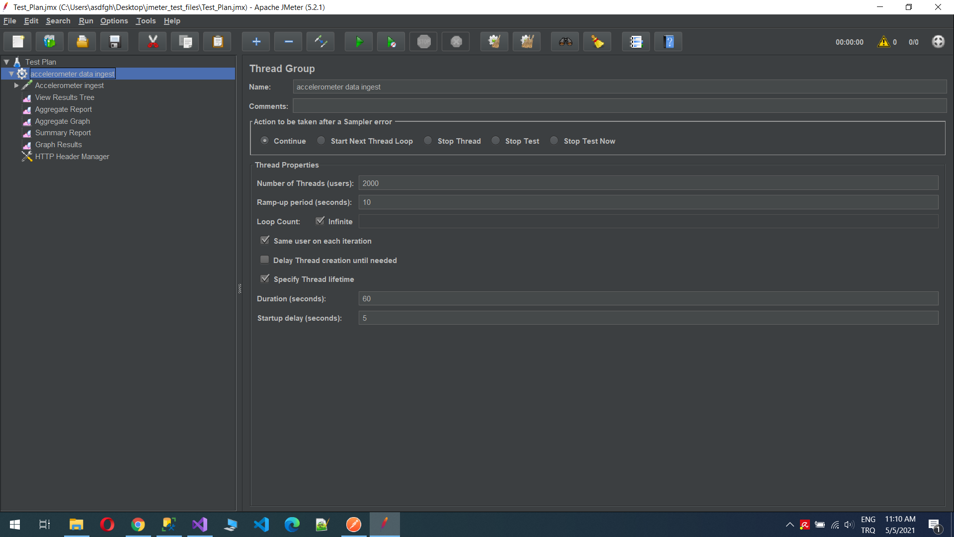
Load Test Configuration (JMETER)

Slide 13
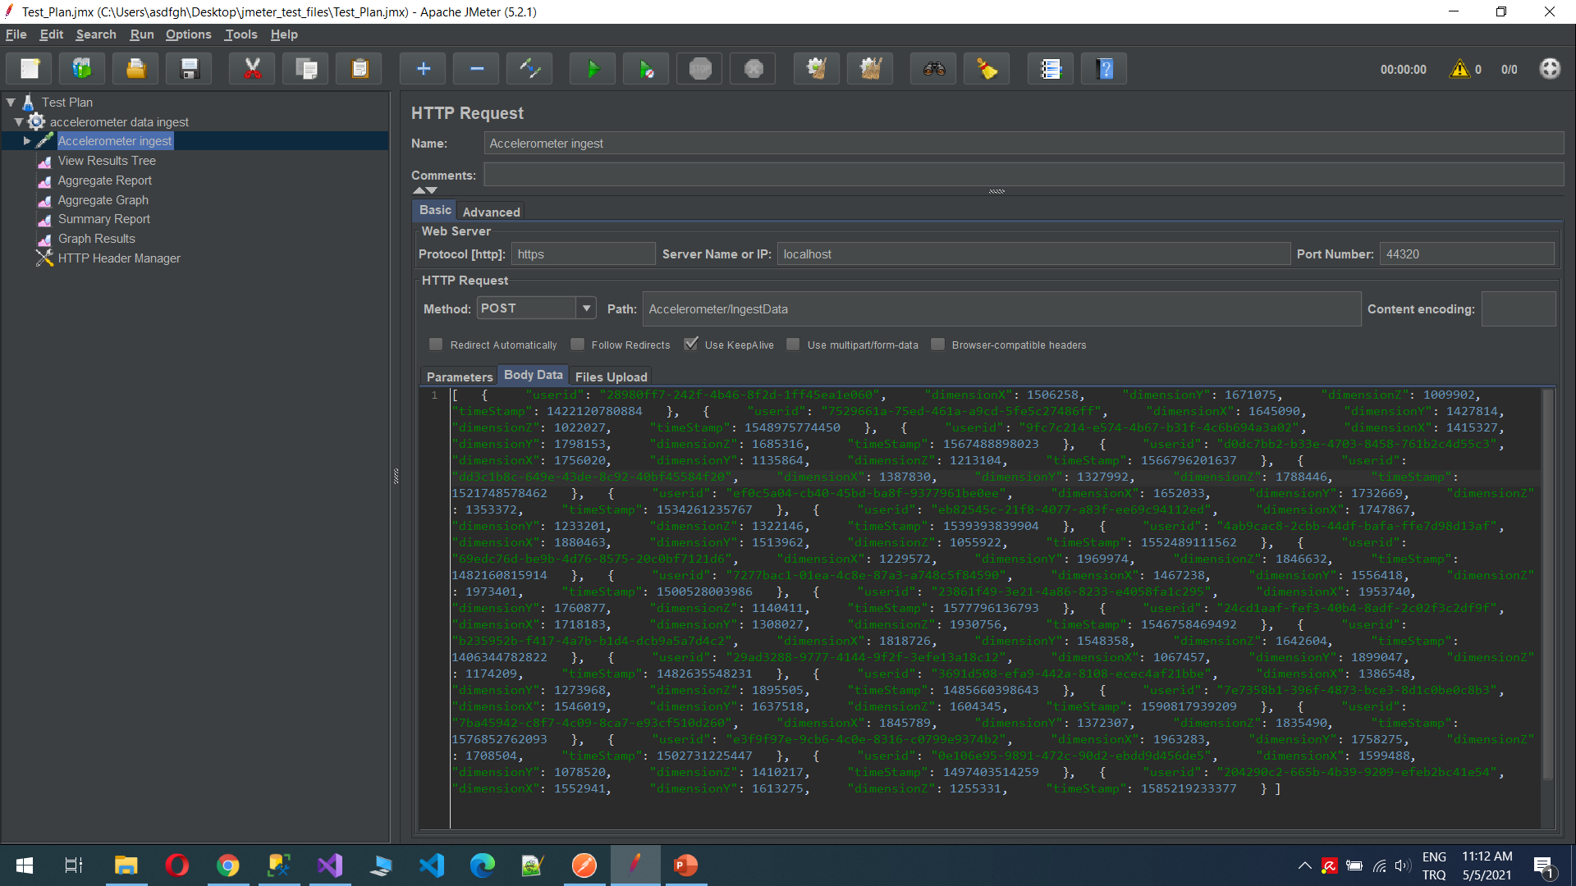
Load Test Data – 20 items for each request

